Slide 1
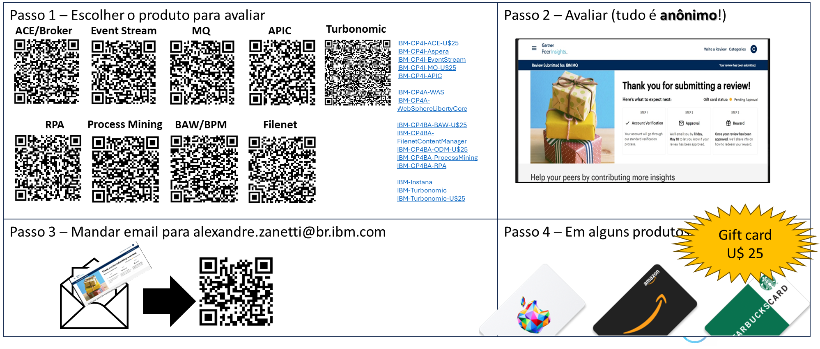

Slide 2



IBM ACE – App Connect Enterprise Avançado - Passos do Ops
Alexandre Zanetti
alexandre.zanetti@br.ibm.com
55 (11) 98539-4632
IBM Advisory Customer Success Manager Technical Specialist
Setembro/2025

Slide 3

Agenda
Revisão
Passos do Ops (Administrador)
Passos do Dev (Desenvolvedor de App)
Ambiente do cliente (Fluxos)
O que há de novo

Slide 4
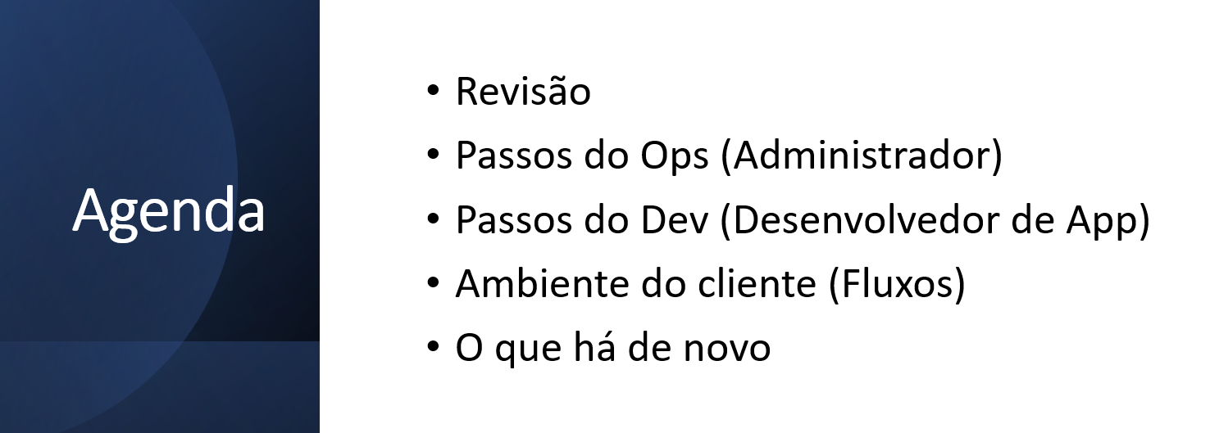
Passos do Ops (Operações)

Slide 5
Esteira/Pipeline,
DevOps
e SRE
DevOps um caminho moderno para:
Entregar App + qualidade e + rápido
Automatizando o ciclo de vida da implantação
Times de Desenvolvimento (Dev) e Operações (Ops) compartilhando responsabilidades
Team
Pipeline / Esteira
Dev
Ops
Site Reliability Engineering (SRE)
SRE usa conhecimentos do times Dev e Ops para automatizar tarefas de operações de IT, e aceletar a entrega dos softwares enquanto minimiza os riscos de IT
"SRE é o que acontece quando pedimos para um time de software desenhar um time de operações”
Ben Treynor Sloss, VP of engineering at Google
"SRE is what happens when you ask a software engineer to design an operations team.”
https://www.ibm.com/cloud/learn/site-reliability-engineering#toc-sre-and-de-Ntrtc6aj
https://sre.google/

Slide 6

Instalar o ACE
cd /opt/IBM/ace-12.0.8.0/
tar -xzvf /tmp/12.0-ACE-LINUXX64-12.0.8.0.tar.gz
./ace make registry global accept license silently
. /opt/IBM/ace-12.0.8.0/server/bin/mqsiprofile
Ops

Slide 7
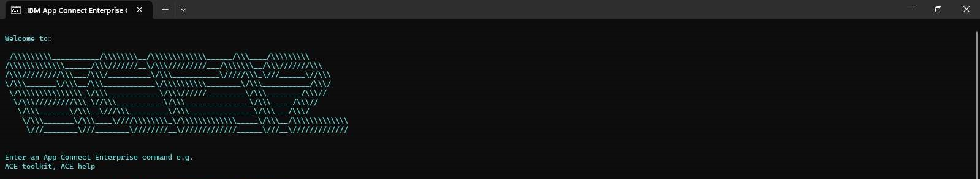
ACE Console
Ops

Slide 8
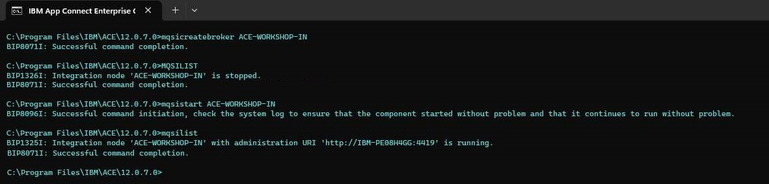

Criando o Integration Node (IN)
mqsicreatebroker ACE-WORKSHOP-IN
mqsistart ACE-WORKSHOP-IN
mqsilist
Ops

Slide 9
Criando o Integration Server (IS) em um IN
mqsicreateexecutiongroup ACE-WORKSHOP-IN -e ACE-WORKSHOP-IS
mqsilist ACE-WORKSHOP-IN
Ops

Slide 10
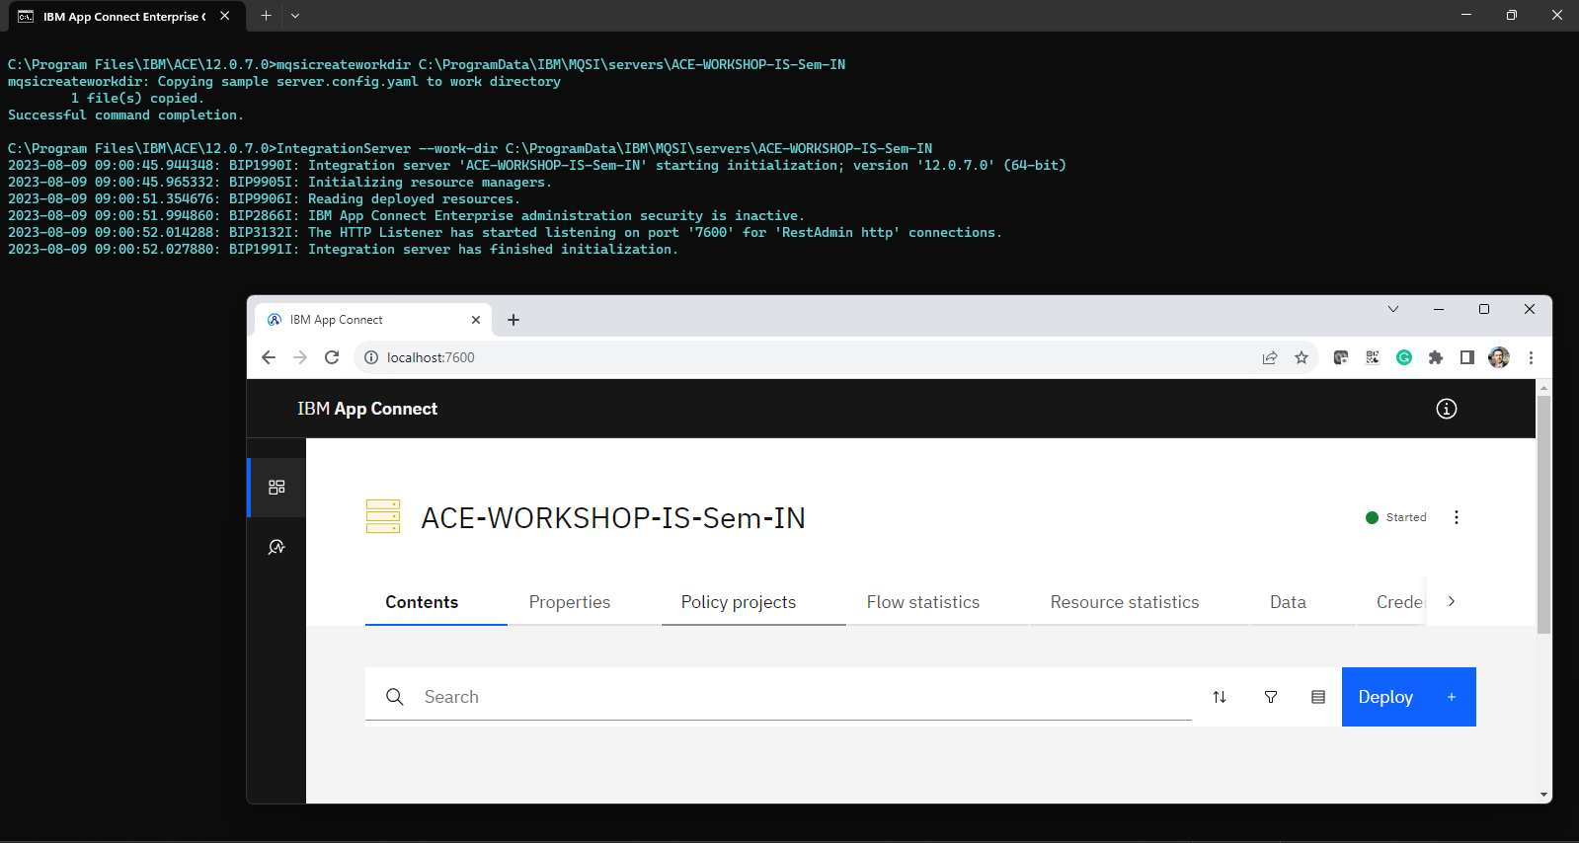
Criando o Integration Server (IS) separado
mqsicreateworkdir C:\ProgramData\IBM\MQSI\servers\ACE-WORKSHOP-IS-Sem-IN
IntegrationServer --work-dir C:\ProgramData\IBM\MQSI\servers\ACE-WORKSHOP-IS-Sem-IN
Ops

Slide 11
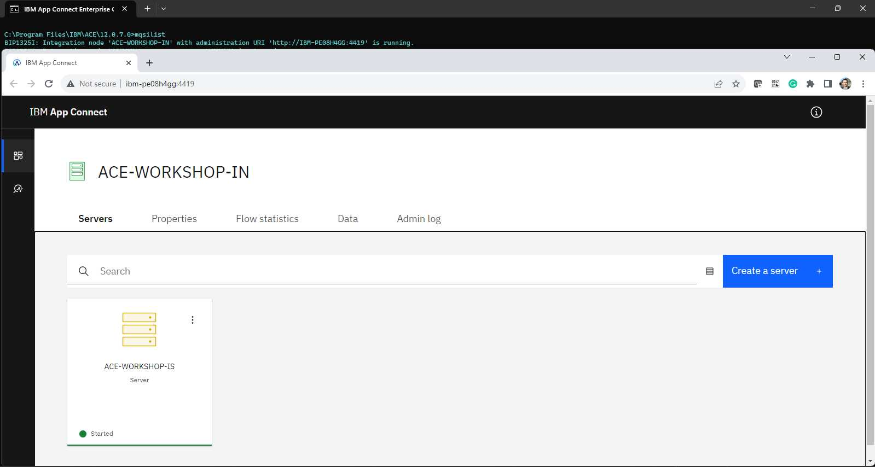
ACE WebConsole

Slide 12
ACE WebConsole

Slide 13
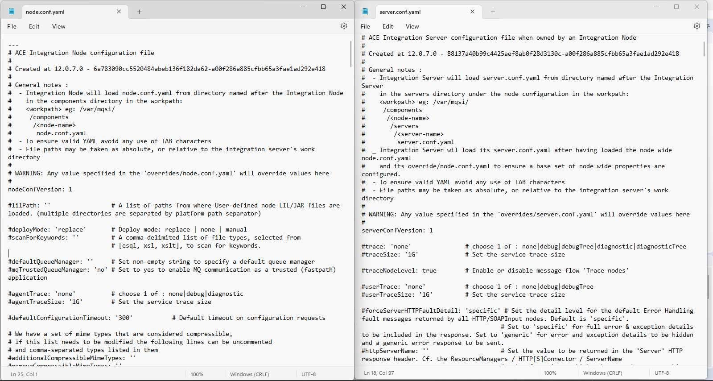
YAML Configurações IN e IS

Slide 14
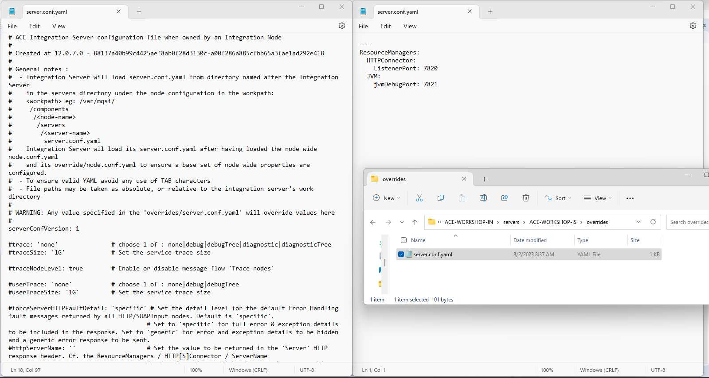
YAML Configurações IN e IS
Configurações do IN
Debug Port
JVM Size
HTTP Port
Listener
Etc

Slide 15
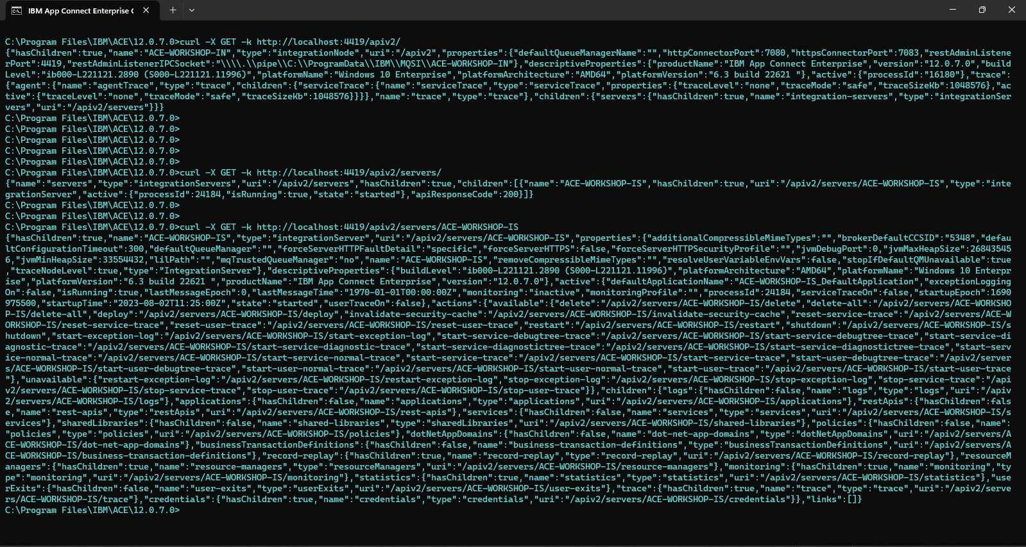
ACE REST
curl -X GET -k https://ibm-pe08h4gg:4414/apiv2/
curl -X GET -k https://ibm-pe08h4gg:4414/apiv2/servers/ZZZ_IS_V13

Slide 16
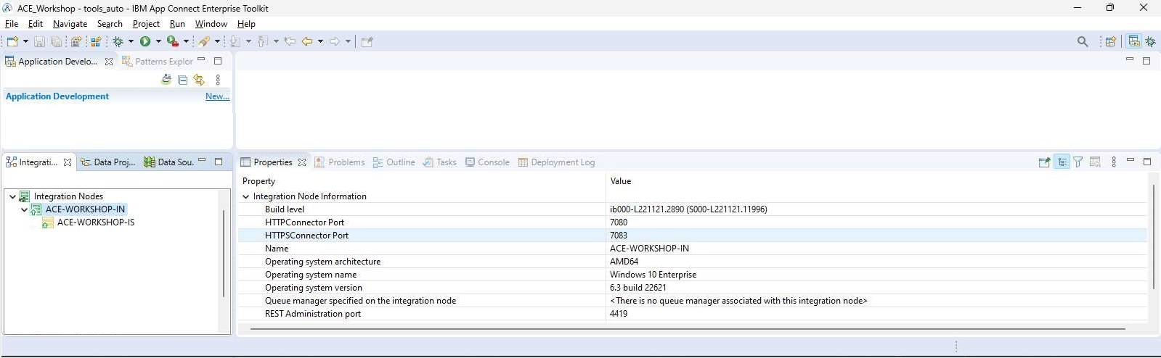
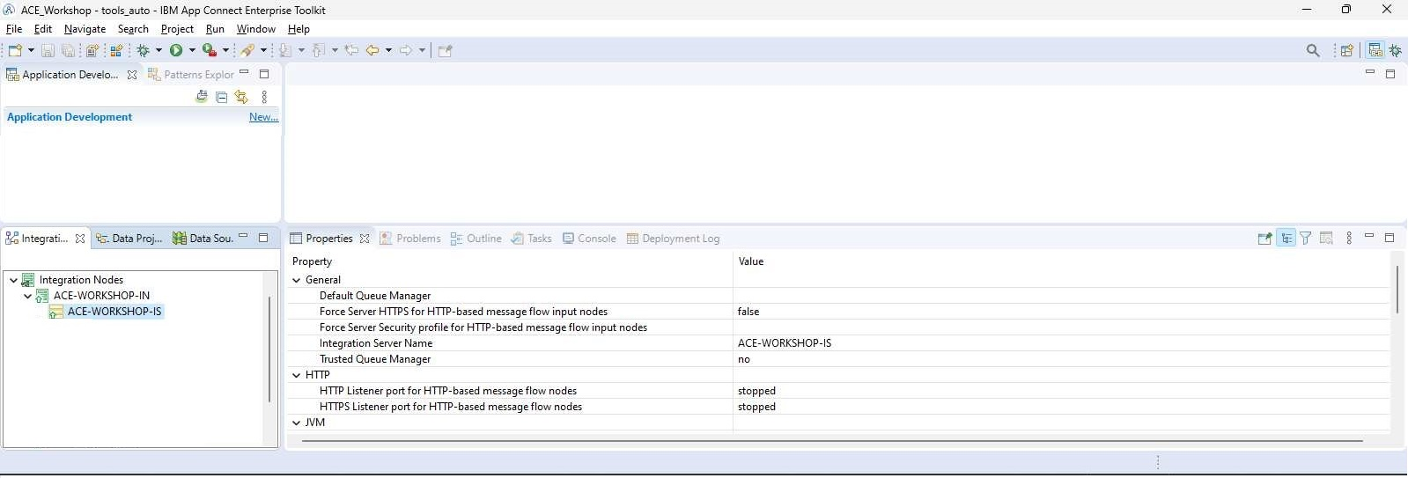
ACE Toolkit IN e IS

Slide 17
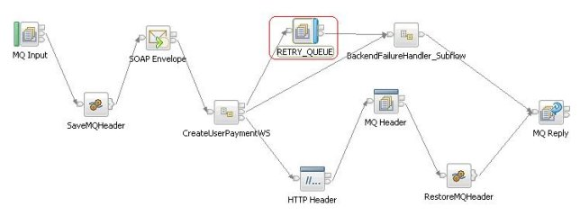
Procedimento de deploy
Create .bar
mqsipackagebar -a ZZZ_SAMPLE_COPYBOOK.bar -w <rootLocation> -k ZZZ_SAMPLE_COPYBOOK
Override .bar com arquivo de “properties”
mqsireadbar -b ZZZ_SAMPLE_COPYBOOK.bar -r
BIP1052I: Reading Bar file using runtime mqsireadbar...
ZZZ_SAMPLE_COPYBOOK.appzip (2/10/21 8:29 PM):
…
ZZZ_SAMPLE_COPYBOOK_OPER2#additionalInstances
…
ZZZ_SAMPLE_COPYBOOK_OPER2#HTTP Input.URLSpecifier = /ZZZ_SAMPLE_COPYBOOK/SVMPW01
…
Policy
mqsiapplybaroverride -b ZZZ_SAMPLE_COPYBOOK.bar –p arquivo_properties.txt –o NOVO_ZZZ_SAMPLE_COPYBOOK.bar
mqsireadbar -b ACE_HTTP_500_Renew_Certfproject.generated.bar -r
.BAR file
.BAR file
ACE
Build
Override
Deploy
Application Message Flow
Arquivo
Properties

Slide 18
Procedimento de deploy CI/CD
Build Environment
Build Data Repository
Artifact Repository
Ex: Nexus
SCM/SVN
Ex: GitLab
CI/CD Process
Prod Runtime
Dev Environment
Test Runtime
Ex: JUnit, Sonarqube

Slide 19
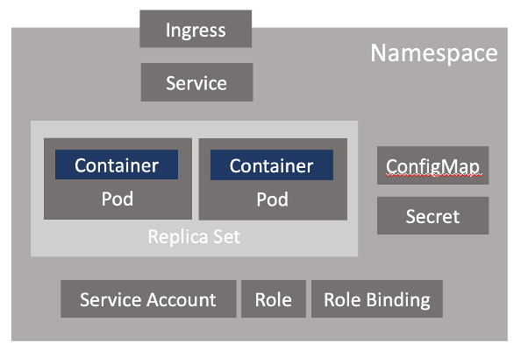
OCP/CP4I - Kubernetes Complexity
https://community.ibm.com/community/user/integration/blogs/rob-convery1/2022/05/11/ibm-app-connect-operators-part-1-what-is-an-operat

Slide 20
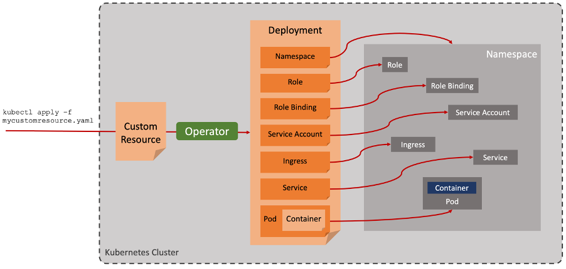
OCP/CP4I - Kubernetes Complexity
https://community.ibm.com/community/user/integration/blogs/rob-convery1/2022/05/11/ibm-app-connect-operators-part-1-what-is-an-operat

Slide 21
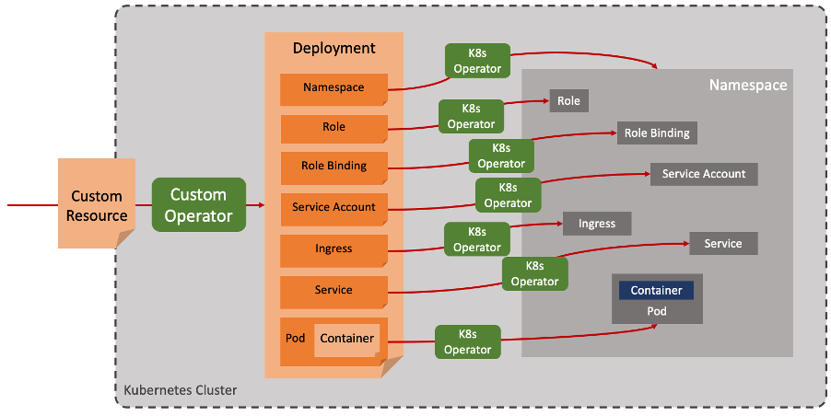
OCP/CP4I - Kubernetes Complexity
https://community.ibm.com/community/user/integration/blogs/rob-convery1/2022/05/11/ibm-app-connect-operators-part-1-what-is-an-operat

Slide 22
OCP/CP4I - IBM App Connect Operator
App Connect Operator
Certified Container
“Integration Server”
Integration Server
Integration
Deploy containerised App Connect Enterprise integrations for an environment
“Configuration”
Custom Resource
Custom Resource
Certified Container
Deploy containerised App Connect Enterprise integrations for each business necessity
Integration Runtime
Certified Container
Integration
Integration Runtime
Certified Container
Integration
“Integration Runtime”
Integration Runtime
Integration
Deploy App Connect Dashboard componentry
“Dashboard”
“Design Authoring”
Deploy App Connect Designer Authoring componentry
“Switch Server”
Deploy App Connect Switch Server
https://community.ibm.com/community/user/integration/blogs/rob-convery1/2022/05/11/ibm-app-connect-operators-part-1-what-is-an-operat

Slide 23
OCP/CP4I - Procedimento de deploy
Content Server (URL)
Integration server:
https://dashboardName-dash:3443/path?token
Integration runtime:
https://dashboardName-dash.namespaceName:3443/path?token
Obs: Parte do App Connect Dashboard
App Connect Dashboard
ACE / CP4I
Integration Server
(“servidor fixo”)
.BAR file
.BAR file
.BAR file
Deploy
URL
.BAR
Integration Runtime
(“servidor para cada deploy”)
Overrides
External repository (URL)
Build Artfacts Repository
Overrides
Overrides
App Toolkit
App Connect Designer
Configurations
Secrets
Configurations
Setdbparm
Policy
db2cli.ini
ccdt
{CI-CD}-
ACE-IS-x
Ou
ACE-IR-y
{CI-CD}-odbc-ini-configuration (data)
{CI-CD}-keystore-jks-configuration
{CI-CD}-keystore-jks-secret (file)
App Connect on IBM Cloud
{CI-CD}-truststore-jks-configuration
{CI-CD}-truststore-jks-secret (file)
{CI-CD}-server-conf-yaml-configuration (data)
{CI-CD}-setdbparms-configuration
{CI-CD}-setdbparms-secret (file)
-ace-ir-config-adminssl
➔ {CI-CD}-adminssl-restadminssl-configuration
?-ace-ir-secret-adminssl
➔ {CI-CD}-adminssl-restadminssl-secret (file)
{SCM}-
GIT
Ou SVM
-ace-ir-bar-configuration
➔ git-repo-barauth-configuration
?-ace-ir-secret-adminssl
➔ {SCM}-repo-barauth-secret
https://www.ibm.com/docs/en/app-connect/containers_cd?topic=resources-integration-server-reference
https://www.ibm.com/docs/en/app-connect/containers_cd?topic=resources-integration-runtime-reference
https://www.ibm.com/docs/en/app-connect/containers_cd?topic=runtimes-barauth-type

Slide 24
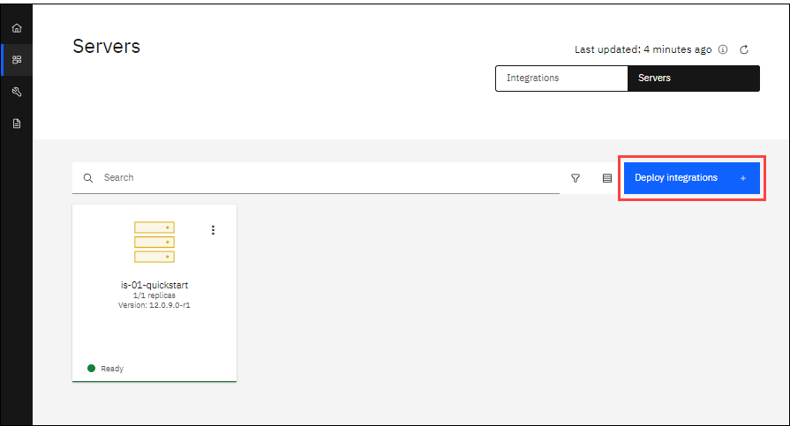
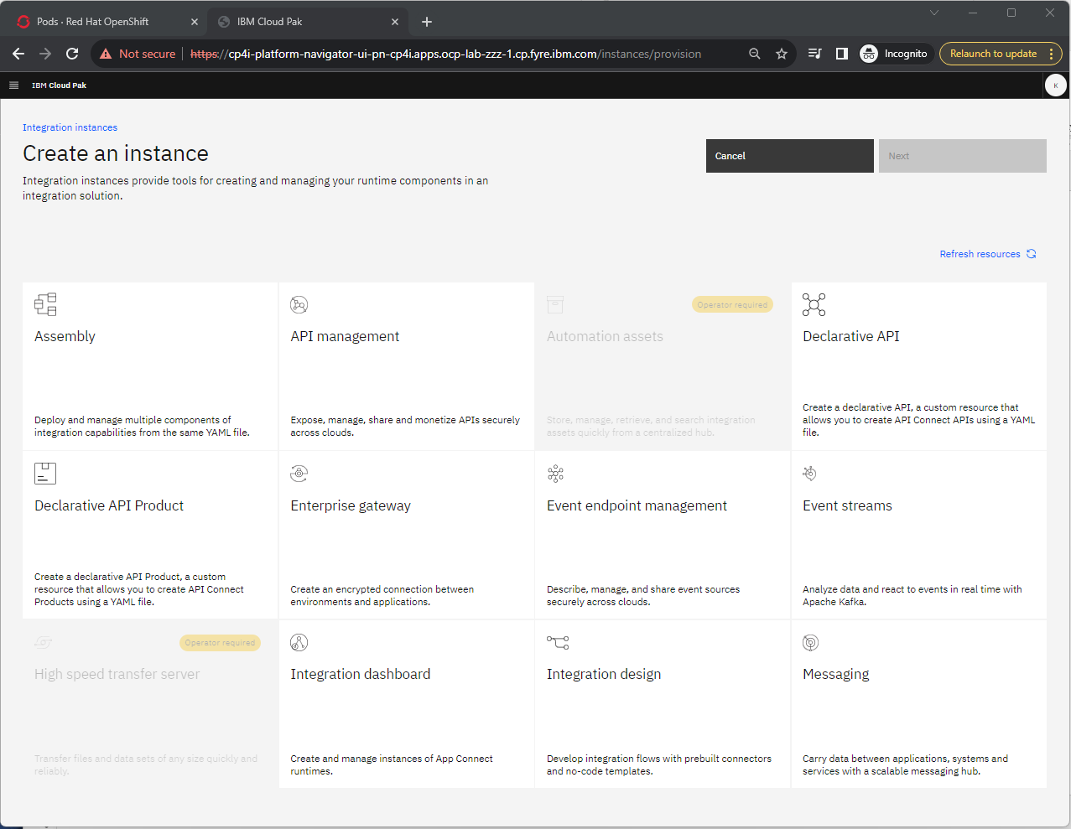
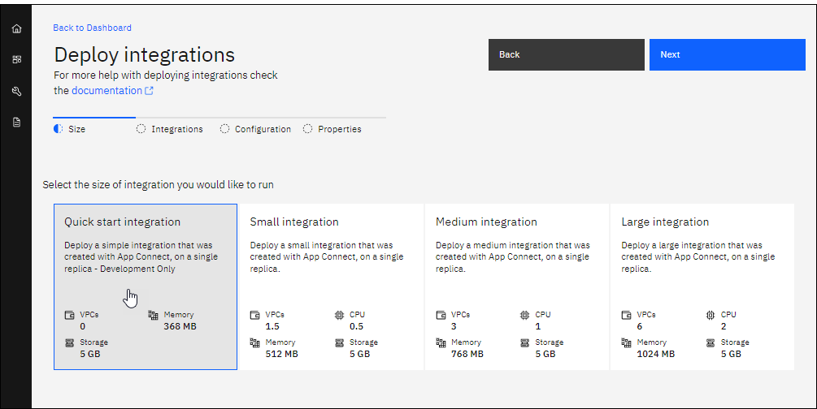
OCP/CP4I - I.Server, I.Runtime, I.Dashboard e I.Design
Integration Server
Platform Navigator
Integration Runtime
https://www.ibm.com/docs/en/app-connect/containers_cd?topic=resources-integration-server-reference
https://www.ibm.com/docs/en/app-connect/containers_cd?topic=resources-integration-runtime-reference
https://www.ibm.com/docs/en/app-connect/containers_cd?topic=runtimes-barauth-type

Slide 25
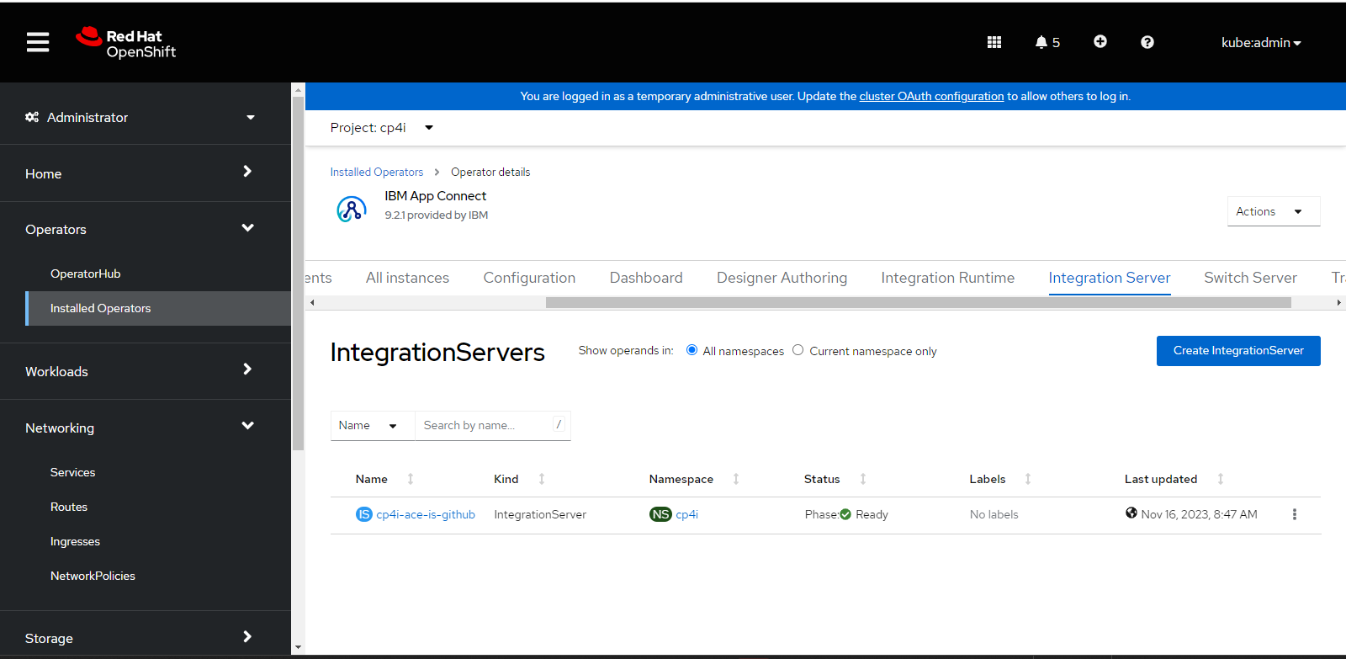
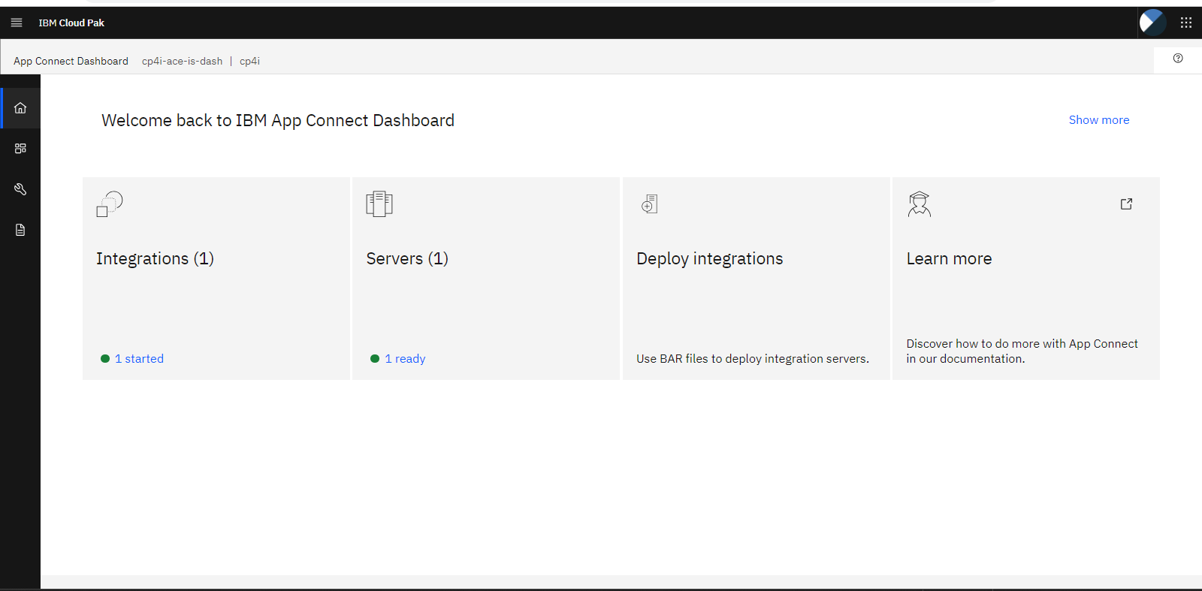
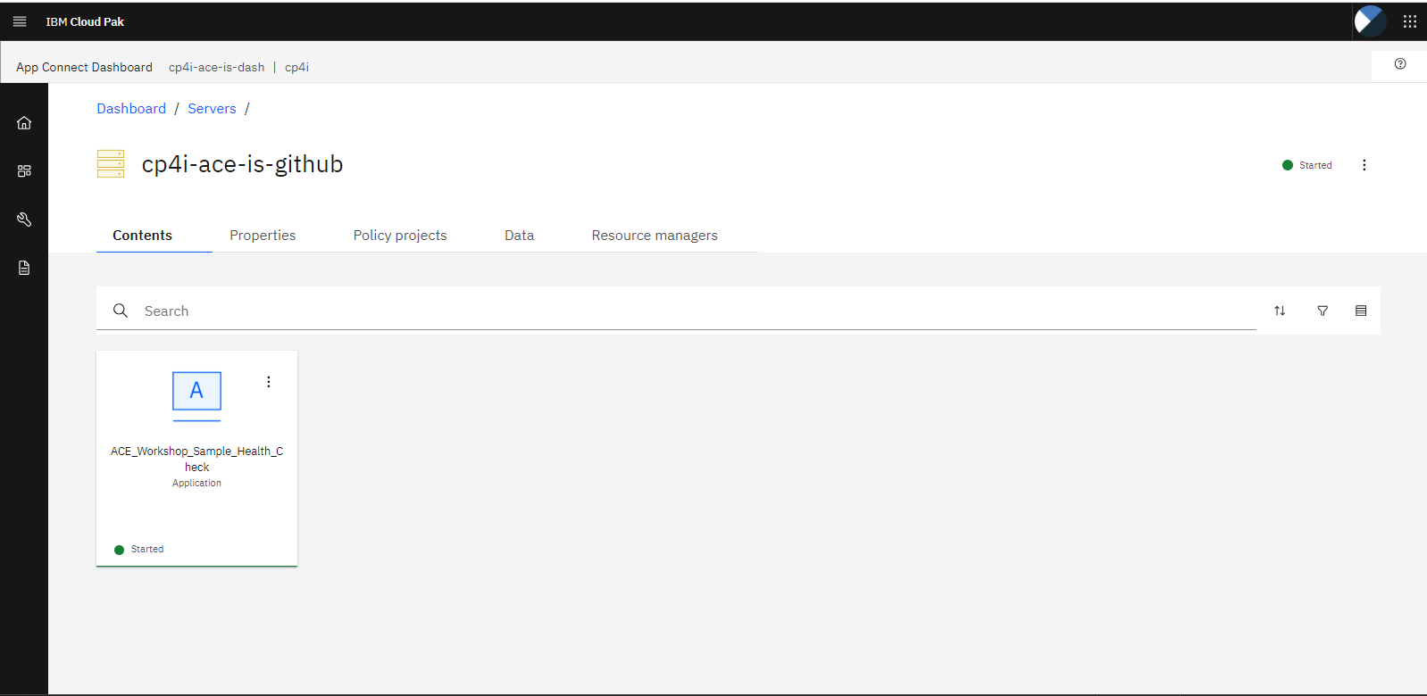
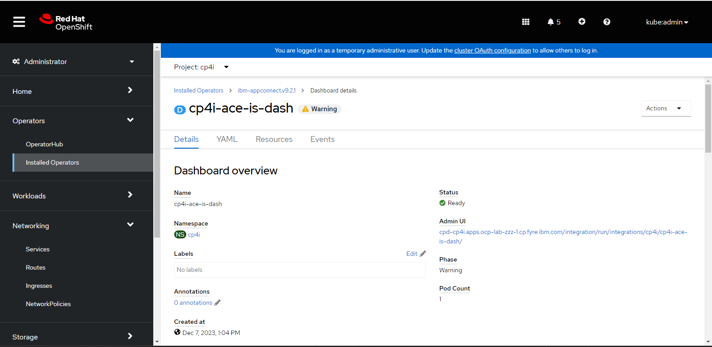
OCP/CP4I - I.Server, I.Runtime, I.Dashboard e I.Design
Integration Server
ACE “WebAdmin” (via Dashboard)
Dashboard
https://www.ibm.com/docs/en/app-connect/containers_cd?topic=resources-integration-server-reference
https://www.ibm.com/docs/en/app-connect/containers_cd?topic=resources-integration-runtime-reference
https://www.ibm.com/docs/en/app-connect/containers_cd?topic=runtimes-barauth-type

Slide 26
Troubleshooting – ACE Data Collector
./aceDataCollector.sh -b ACE-WORKSHOP-IN -e ACE-WORKSHOP-IS
Obs: trace de IS de um IN
./aceDataCollector.sh -b ACE-WORKSHOP-IN
Obs: trace de IN
./aceDataCollector.sh –w {workDir}
Obs: trace de IS
https://www.ibm.com/support/pages/app-connect-enterprise-data-collector-script
Ops

Slide 27
Troubleshooting – Traces do IS
1. Start trace.
mqsichangetrace ACE-WORKSHOP-IN -e ACE-WORKSHOP-IS -t -l debug -r -c 2000000
2. Wait for X minutes.
3. Stop trace.
mqsichangetrace ACE-WORKSHOP-IN -e ACE-WORKSHOP-IS -t -l none
Traces are written to the Integration Server's work directory or the multi-user work path:
- <workdir>/config/common/log
- /var/mqsi/common/log (AIX and Linux)
- C:\ProgramData\IBM\mqsi\common\log (Windows)
https://www.ibm.com/support/pages/collecting-service-level-trace-ace-integration-server
Ops

Slide 28
Troubleshooting – Diretórios úteis
Log/Error
/var/log/message
Logs/Traces do ACE
- <workdir>/config/common/log
- /var/mqsi/common/log (AIX and Linux)
- C:\ProgramData\IBM\mqsi\common\log (Windows)
Ops

Slide 29
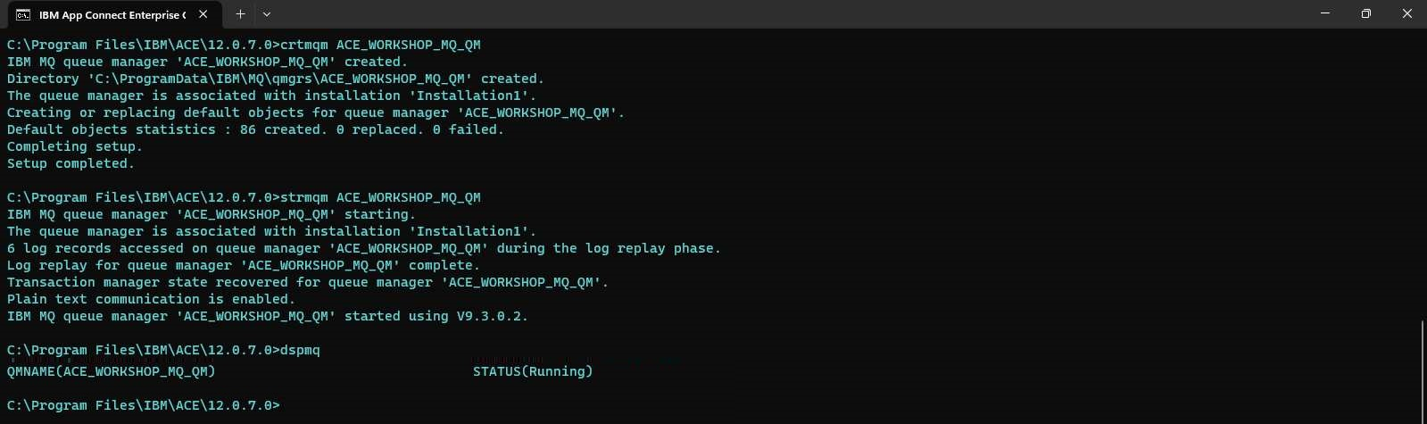
Criando um “MQ” (para policy)
crtmqm ACE_WORKSHOP_MQ_QM
strmqm ACE_WORKSHOP_MQ_QM
dspmq
Ops

Slide 30

Dúvidas
Alexandre Zanetti
alexandre.zanetti@br.ibm.com
55 (11) 98539-4632
IBM Advisory Customer Success Manager Technical Specialist

Slide 31
Referências

Slide 32
Referências
ACE 11 e ACE 12 https://www.ibm.com/support/knowledgecenter/en/SSTTDS_12.0.0/com.ibm.ace.home.doc/help_home.htm
https://www.ibm.com/docs/en/app-connect/12.0
ACE – Comandos https://www.ibm.com/support/knowledgecenter/en/SSTTDS_11.0.0/com.ibm.etools.mft.doc/an07060_.html
https://www.ibm.com/docs/en/app-connect/12.0?topic=administration-app-connect-enterprise-commands
ACE – Policies overview https://www.ibm.com/support/knowledgecenter/SSTTDS_11.0.0/com.ibm.etools.mft.doc/py00106_.html
https://www.ibm.com/docs/en/app-connect/12.0?topic=policies-overview
ACE – FAQ, Tutorials, Performance Reports, etc. https://developer.ibm.com/integration/docs/app-connect-enterprise/
ACE – REST https://www.ibm.com/docs/en/app-connect/12.0?topic=mrbuara-updating-https-connector-resource-manager-by-using-administration-rest-api

Slide 33


